Slide 1
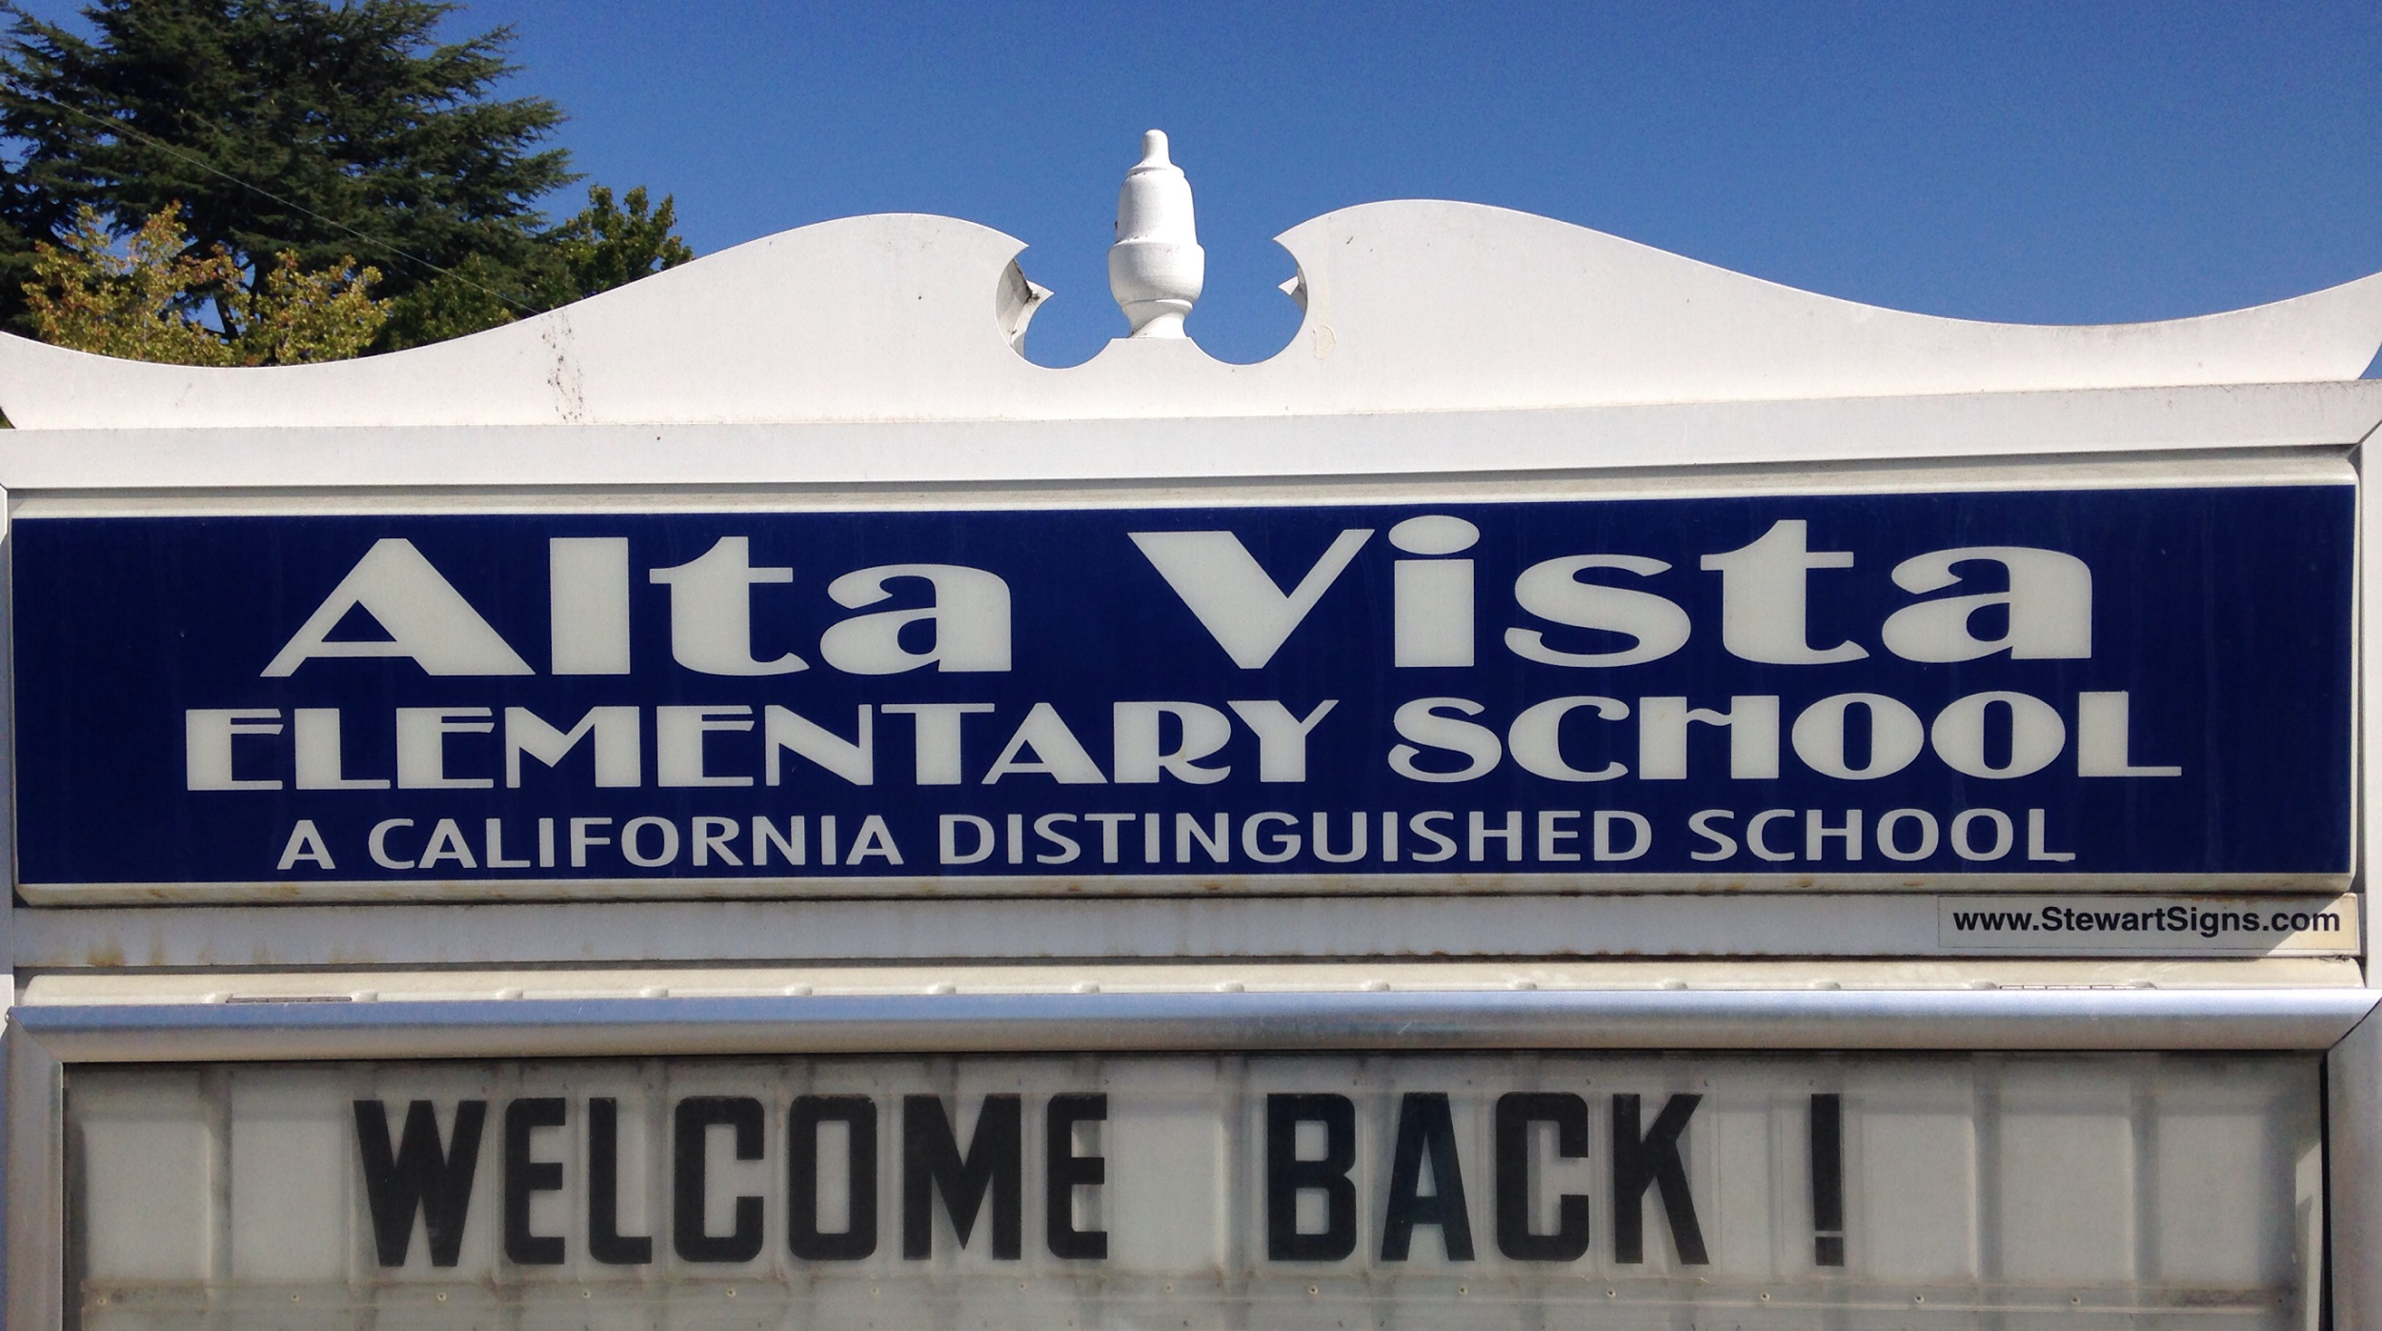

Slide 2
2016 - 2017 AVHSC Board Members
President Jane Findley
Vice President Jessica Winter
Treasurers Erin Kasenchak & Sunghee Park
Auditor John Hart
VP of Membership Rebecca Bond
VPs of Fundraising Jill Brehmer & Asma Ghori
VP of Enrichment Rita Halbach & Lizl Pienaar
Recording Secretary Stacy Badgis
Corresponding Secretary Karen Jacobs
Historian Sarah Wager-Ratinoff
Parliamentarian Elizabeth Ramirez
Teacher Reps Nikki Grist & Liz Werner
Principal Joy Shmueli
Meetings on 2nd Tuesday of each month at 6pm

Slide 3
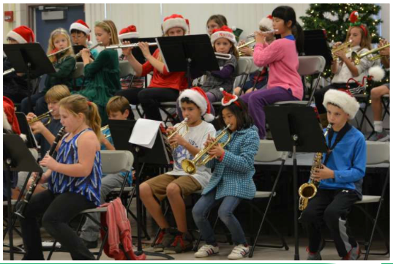
We Sponsor
Movie Night
Walk-a-Thon
Book Fair
Family Valentine’s Dance
Spring Auction and Hawaiian Luau
Multicultural Night & Science Night
Fantasy Faire
Spring Music Concerts, Variety & Art Shows

Slide 4
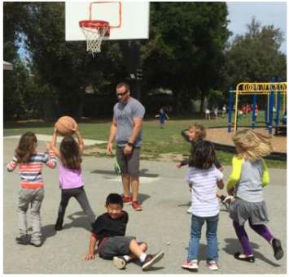
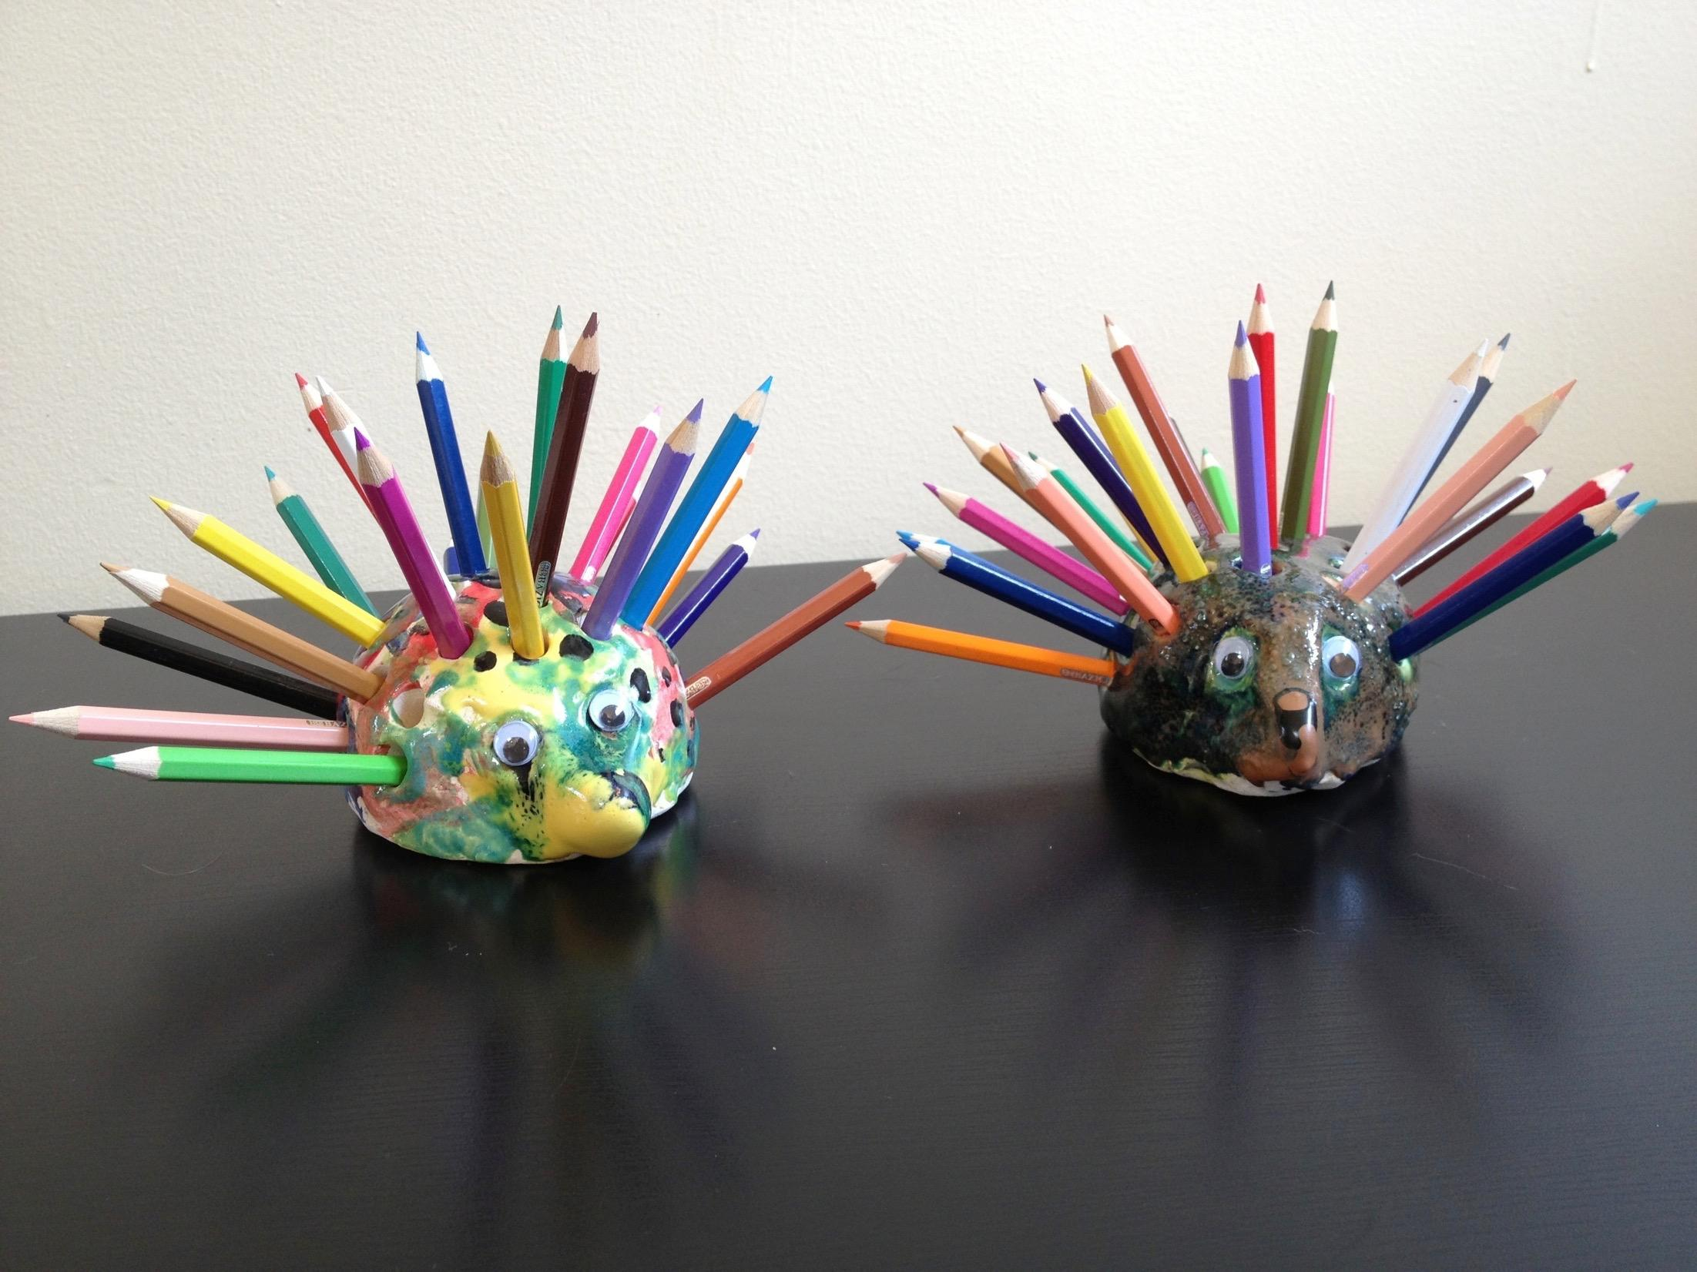
We Volunteer
Art Vistas
Clay
Project Cornerstone
PE
Mileage Club
Library

Slide 5
We Fund
Direct Student Supplies, Field Trips, Class T-Shirts
Physical Education / Recess Activities
Music & Performing Arts
Technology
Classroom Supplies
Other Enrichment Programs & Costs
Average Cost of Programs: $300 per Student

Slide 6
Our 3 Major Fundraisers
Consolidated Class Pledge (CCP) & Donation Drive
Goal $50K
Walk-a-Thon
Saturday, October 15
Goal $60K
Spring Auction & Hawaiian Luau
Saturday, March 18, 2016
Goal $35K

Slide 7
Stay Connected through School Blasts
Access Online Directory or Purchase Print Directory
Sign-Up to Volunteer for Classroom Enrichment
New Online School Store - No More Checks!
CCP & Donation Drive
Spirit Wear, Birthday Books
Event Tickets

Slide 9
Treasurers’ Report
2016/2017 Budget
Erin Kasenchak & Sunghee Park

Slide 10
INCOME BUDGET 2016/2017
INCOME | 2016/2017 | 2015/2016
 | BUDGET | BUDGET | ACTUAL
DONATIONS | $10,000 | $10,000 | $5,761
WALK-A-THON (plus Science Camp) | $60,000 | $65,000 | $60,885
BIRTHDAY BOOKS/BOOK FAIR | $4,500 | $5,200 | $5,235
SPRING AUCTION | $35,000 | $45,000 | $40,665
AV COUGAR WEAR (Spirit-Wear) | $1,000 | $750 | ($973)
E-SCRIP | $5,000 | $1,000 | $7,098
SPONSORSHIPS | $10,000 | $10,000 | $9,156
COMPANY MATCH | $11,000 | $10,000 | $11,390
OTHER FUNDRAISERS (Amazon.com, Book Fair, Box Tops, Dining Out, Fantasy Faire) | $7,800 | $10,500 | $7,188
CONSOLIDATED CLASS PLEDGES (including est.15% shortfall) | ($9,630) | ($8,415) | ($753)
TOTAL INCOME | $139,070 | $146,335 | $150,792

Slide 11
EXPENSE BUDGET 2016/2017
EXPENSES | 2016/2017 | 2015/2016
 | BUDGET | BUDGET | ACTUAL
BUSES / CROSSING GUARD / HSC EXPENSE | $31,200 | $31,000 | $25,838
FACULTY SUPPORT | $29,100 | $28,300 | $22,867
SCHOOL PROGRAMS:
TECHNOLOGY / GRANTS | $25,000 | $35,000 | $16,649
OTHER SCHOOL PROGRAMS | $6,100 | $4,375 | ($2,291)
TOTAL SCHOOL PROGRAMS | $31,100 | $39,375 | $13,728
STUDENT PROGRAMS:
ART VISTAS / CLAY | $6,500 | $6,500 | $6,079
PERFORMING ARTS / MUSIC | $26,000 | $26,000 | $8,370
PE RECESS 101 PROGRAM | $35,500 | $43,625 | $43,679
OTHER STUDENT PROGRAMS | $17,900 | $17,700 | $41,519
TOTAL STUDENT PROGRAMS | $85,900 | $93,825 | $99,647
TOTAL EXPENSES | $177,300 | $192,500 | $162,081

Slide 12
FINANCIAL PROJECTION FOR 2016/2017
NET EQUITY AS OF 7/1/2016 | $109,905
ADD: PROJECTED INCOME | $139,070
LESS: PROJECTED EXPENSES | ($177,300)
LESS: LT CAPITAL IMPROVEMENTS RESERVE | ($20,000)
PROJECTED NET BALANCE AS OF 6/30/17 | $51,675

Slide 13
MAJOR BUDGET INITIATIVES FOR 2016/17
TECHNOLOGY
PHYSICAL EDUCATION
MUSIC & PERFORMING ARTS
ENRICHMENT PROGRAMS
CLASSROOM FUNDS

Slide 14
Membership Budget Vote
Thank You!

